Slide 1
15 Learnings from Open Source in Go
by @nikolaydubina
2023-08-25

Slide 2
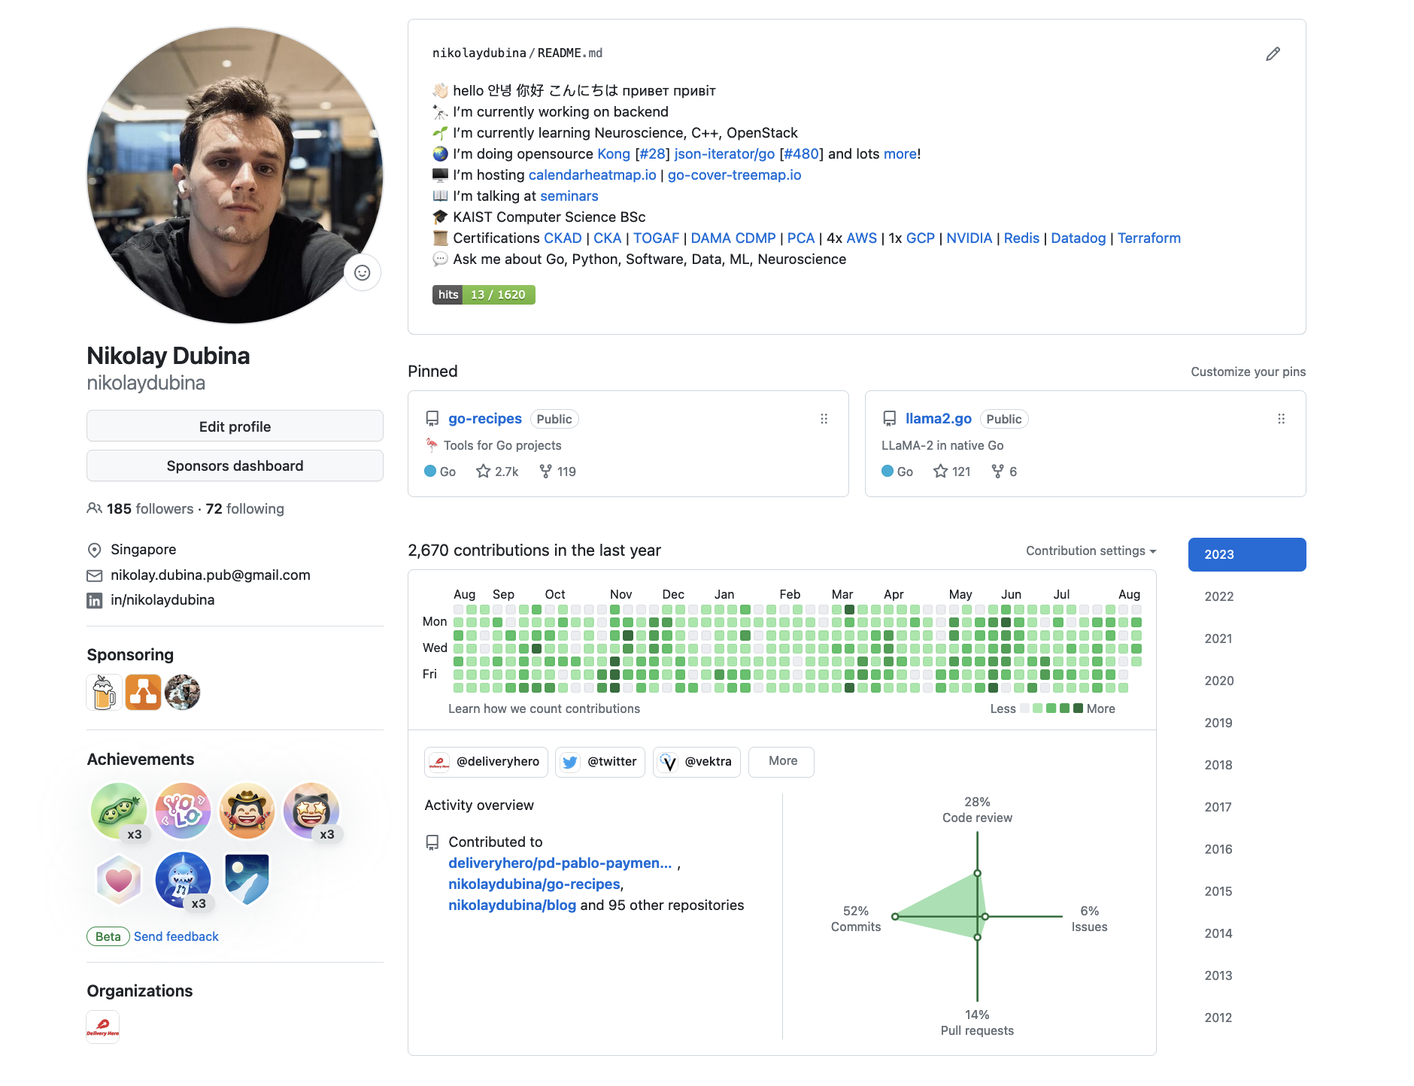
About me
github.com/nikolaydubina
4+ years of open source
8+ years professionally SWE
50+ open source projects
PRs to major projects
top achievements
2.7K stars in one project
trending on GitHub Explore
many appearances in golang-weekly

Slide 3
You are not going to get paid for this
Open Source is notoriously hard to sell
Patreon, GitHub Sponsors pays absolute zero
multi-billion companies using your stuff would not pay you even 5$
saw this myself, but countless examples, case in point: numpy
Hard to even get likes
like rate is <1%
Recruiters do not care about it
Interviewers do not care about it
Your Employer do not care about it
zero impact in yearly reviews
or even negative impact to your performance (surprising!)
many big employers outright legally prohibit it (Google, Meta, Qualcomm, ...)

Slide 4
So why to do it?
One of the very few things that will outlive internal code at your work
or even your time at company
or even your company
or even your career
Your brand
Learn what you do not know
Show what you do know
Bring something new to life 🌱

Slide 5
Tips

Slide 6
Tip: Very different from your dayjob
Expect that you can spend only minimum effort
You are working unpaid, tired after work, in your free time at expense of other activities (i.e. life)
Thus
no complex CI/CD setups
no over-optimizations
no exhaustive tests
tests are very useful of course, just not expect to make a lot of them
some projects actively benefit from no tests
you can focus 80/100 time on tests or on feature. you have limited pool of time. use wisely.
no complex infra setups
AWS Lightsail instead of AWS EKS
GitHub Pages for web-hosting whenever possible
GitHub Actions for CI
Codecov for coverage

Slide 7
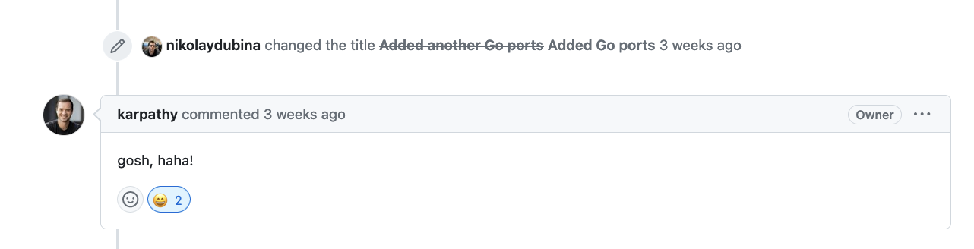
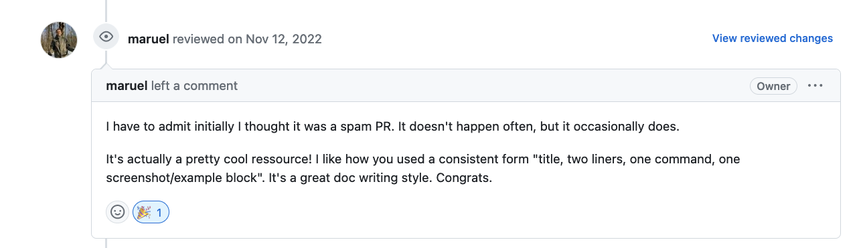
Tip: People
you are on your own
community is full of random people
they have no stake in your project
you have no stake in their project
majority is not qualified
1% wants to do actual work
interactions with fellow SWEs spread around world is nice
interactions with legendary people is nice

Slide 8
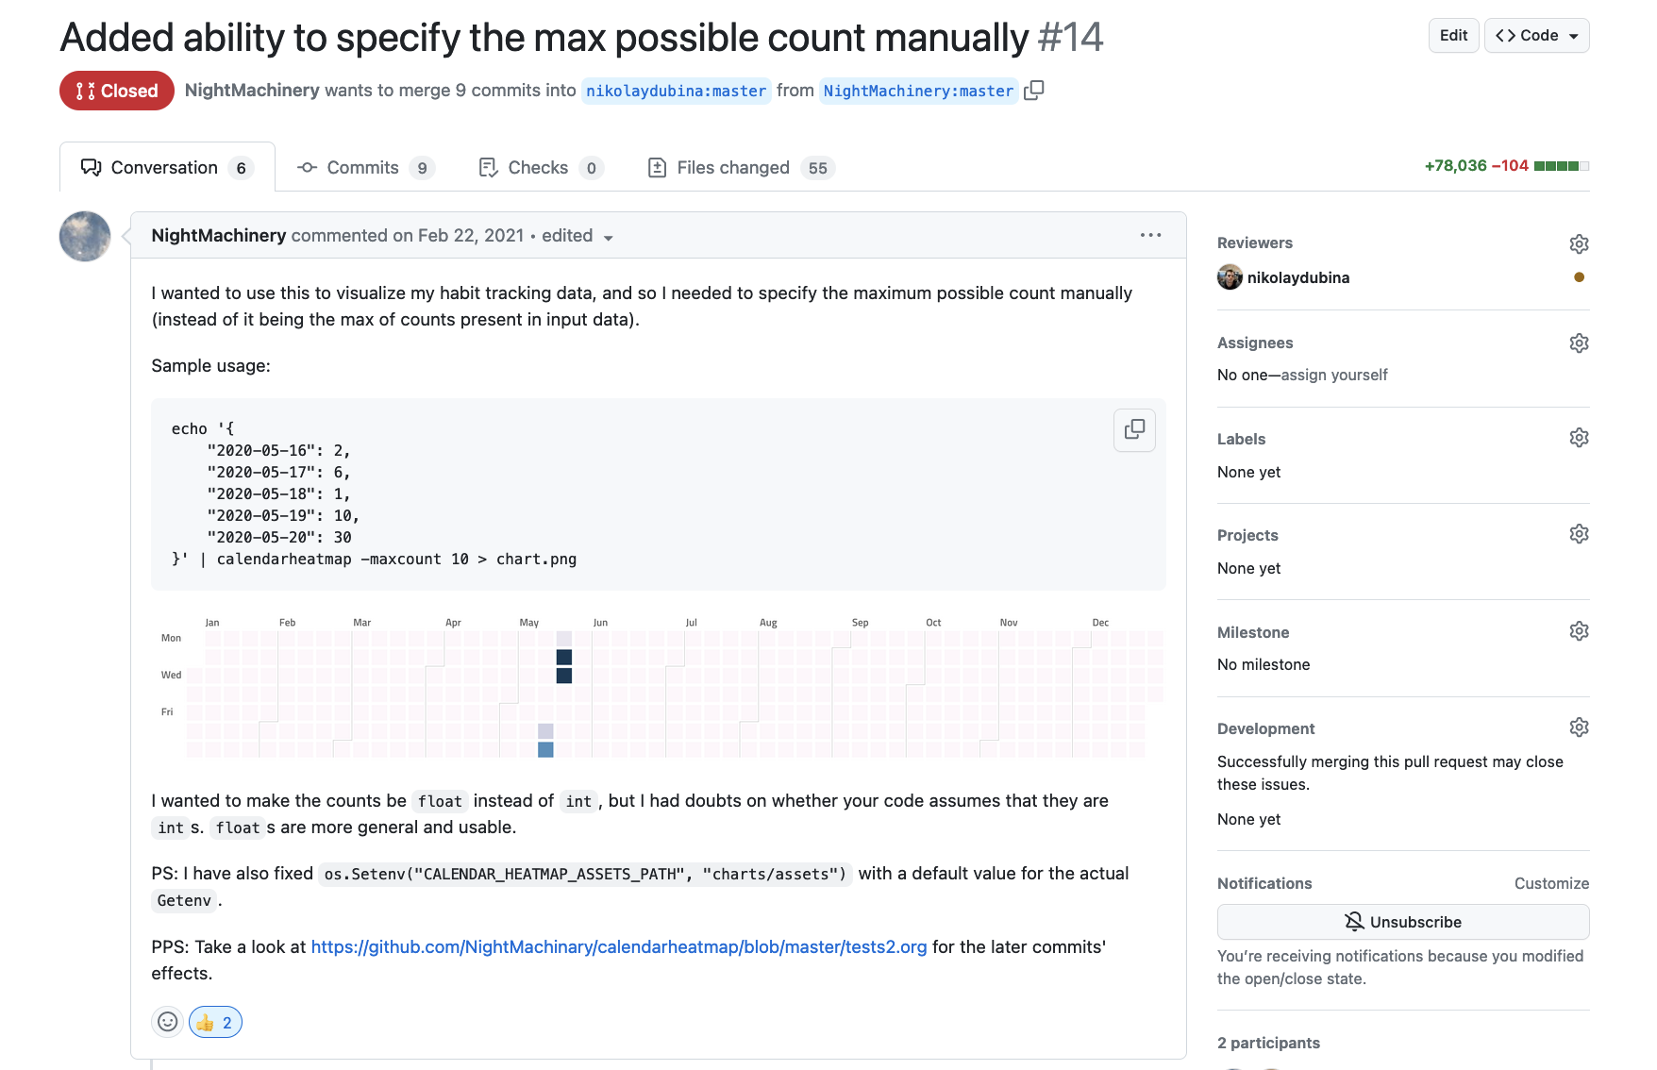

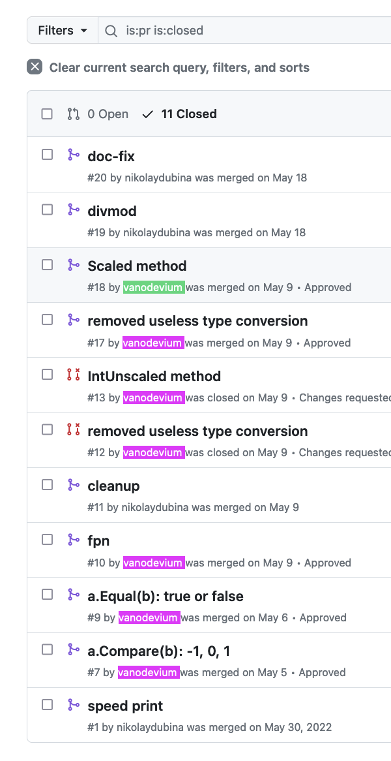
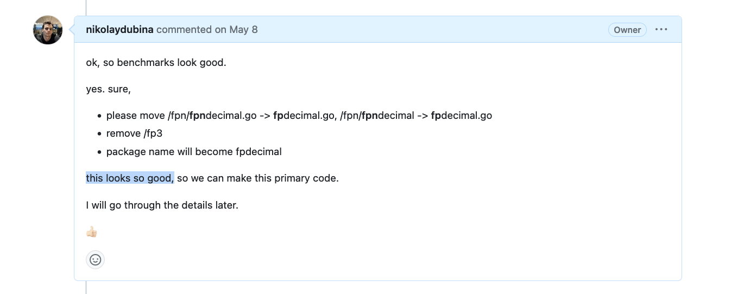
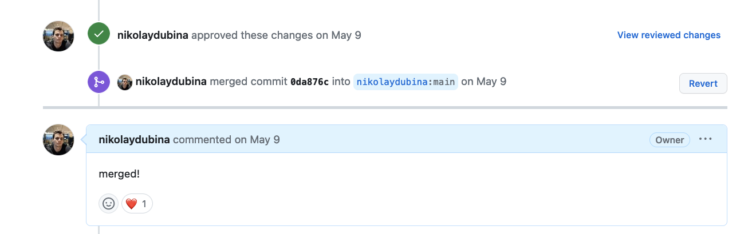
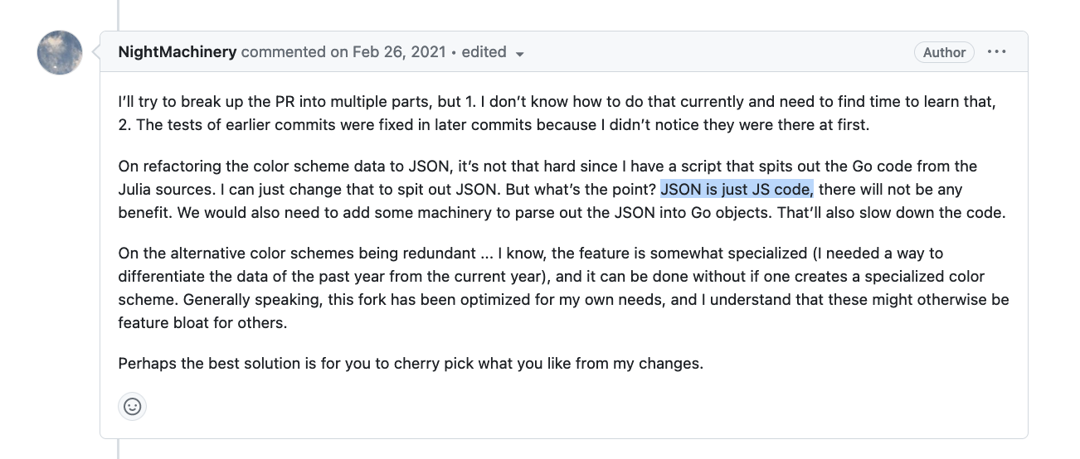
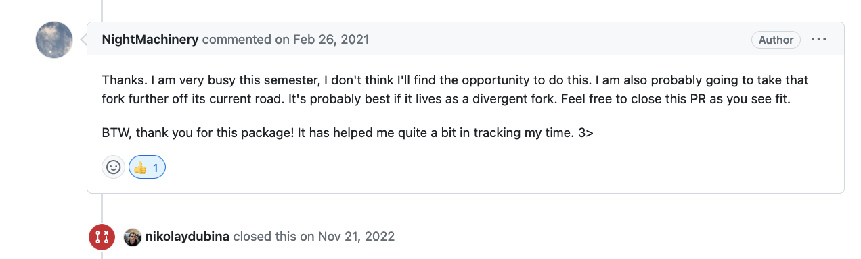
Tip: People Contributions
happens rarely
99% are beginners
1% is very good
expect to step-in to unblock

Slide 9
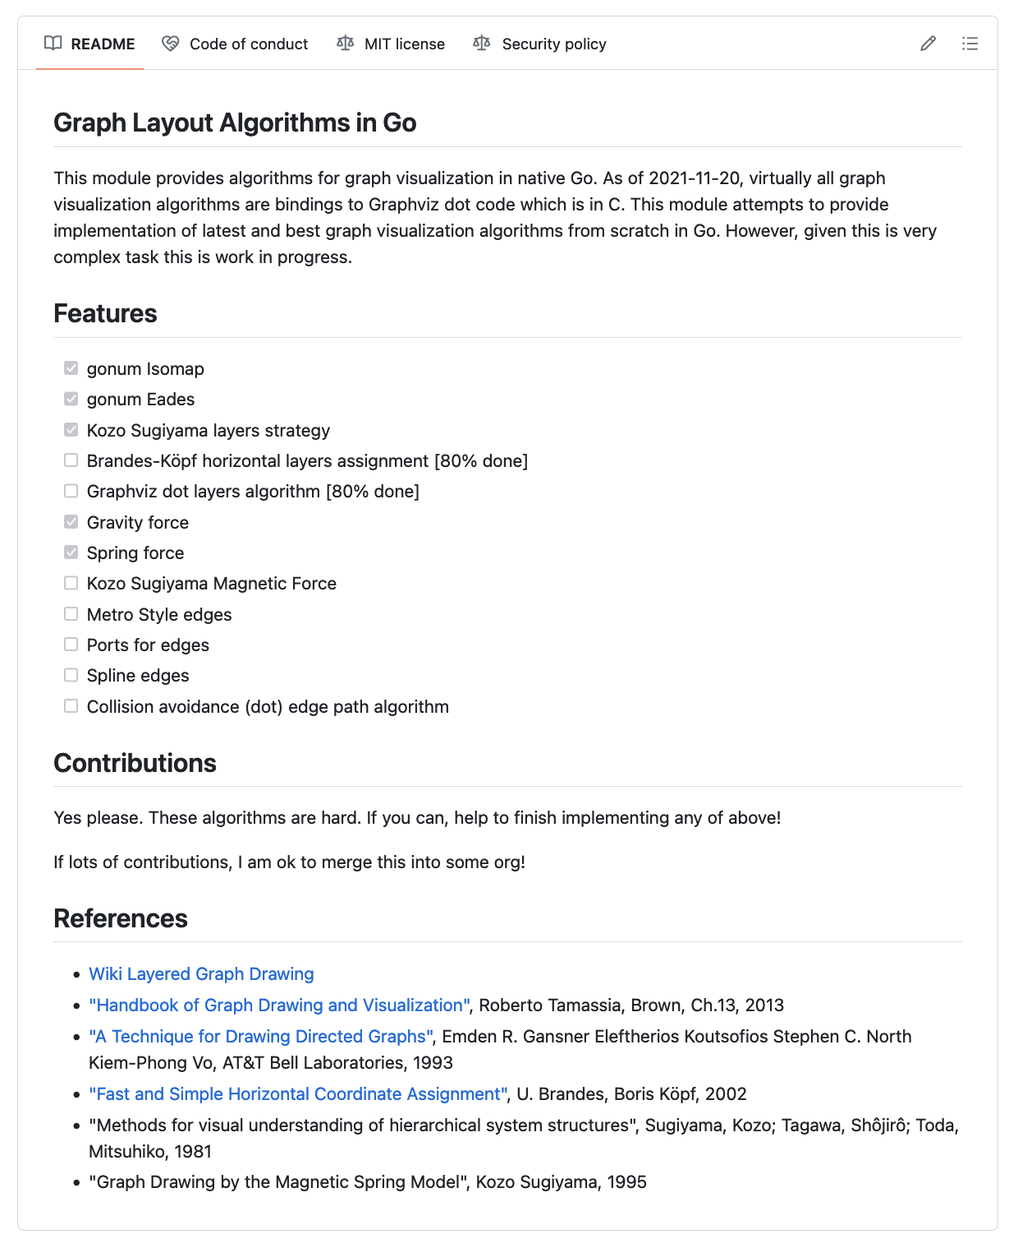
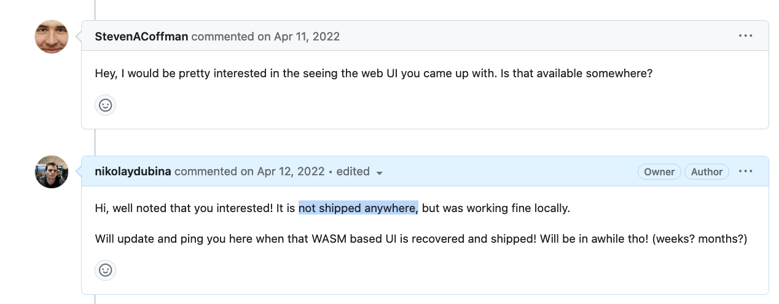
Tip: Always finish what you start
Worst is work for years on something nobody wants and not even finish it
saw this myself in other people's projects multiple times
I have few big projects that failed after months of effort. It is the worst.
e.g. "native Go graph layout rendering (aka Graphviz in Go)"
Feeling to give up halfway through is real and is regular
especially if you doing something hard and valuable

Slide 10
Tip: Ship ASAP
Pick projects that you can finish in chunks or even at once
You may lose context and interest and passion over time
You may find something better to do (i.e. life), Negative feedback may kick-in
Account for energy you have
energy
time
try to finish at least MVP while you are here

Slide 11
Tip: Publish, don't Delete
Ship ASAP to get feedback ASAP and move on
Publishing half-finished projects that are at risk of abandoning is ok too

Slide 12
Tip: Community Channels are important
channel | reach | people | timeline | notes
reddit.com/r/golang/ | large | beginner | short term | not much negative feedback especially good if you hit enough traction at start, it amplifies already successful things well
groups.google.com/g/golang-nuts | small | mid, senior | long term
golangweekly.com | large | beginner, mid, senior, professionals | short term | to get here you need to get trending in other places already (GitHub, /r/golang, etc.)
github.com | large | beginner, mid, senior, professionals, very senior | long term | to get here you need critical mass looks like smallest critical mass you need
awesome lists | small | beginner, mid, senior, professionals | long term
x.com (twitter) | medium | senior, professionals | long term
blogs | medium |  | long term | surprising
hacker news | small | senior, professionals | short term | surprising to get here you need very very critical mass
youtube | ? | ? | ?
google scholar, arxiv | zero | academics | long term | absolute zero here

Slide 13
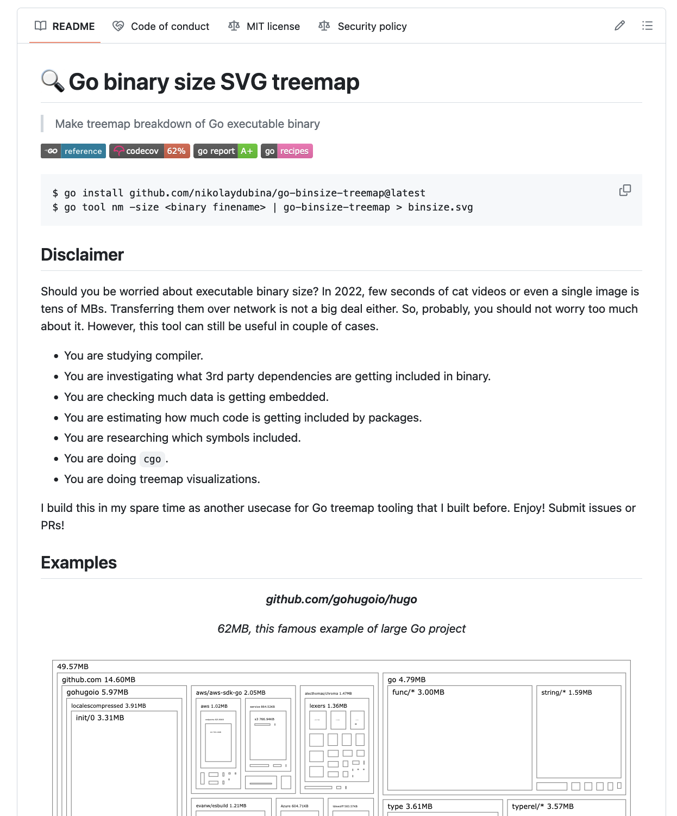
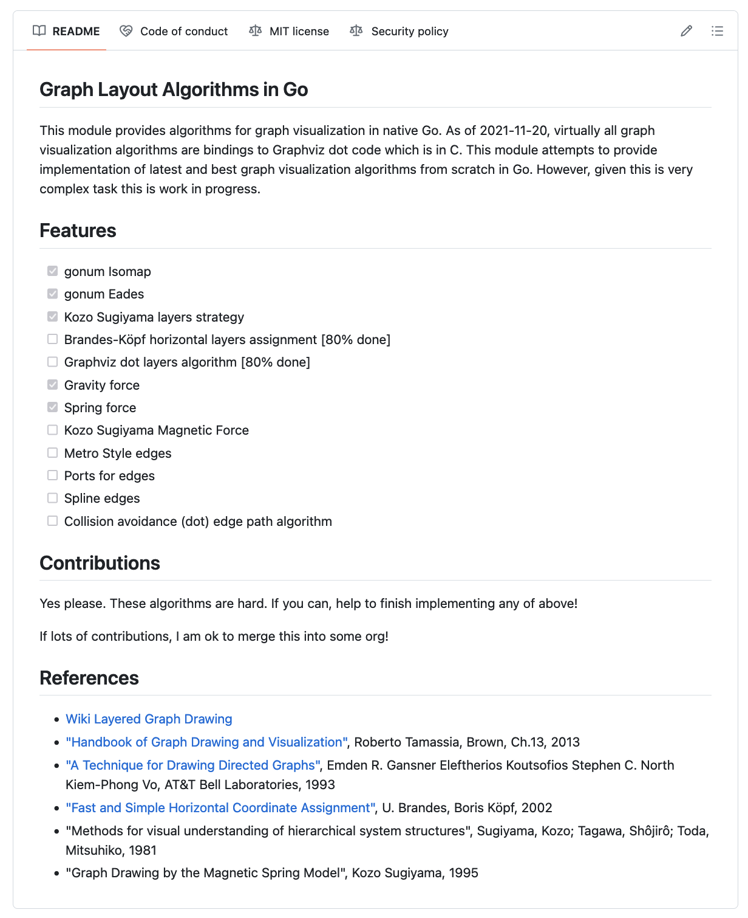


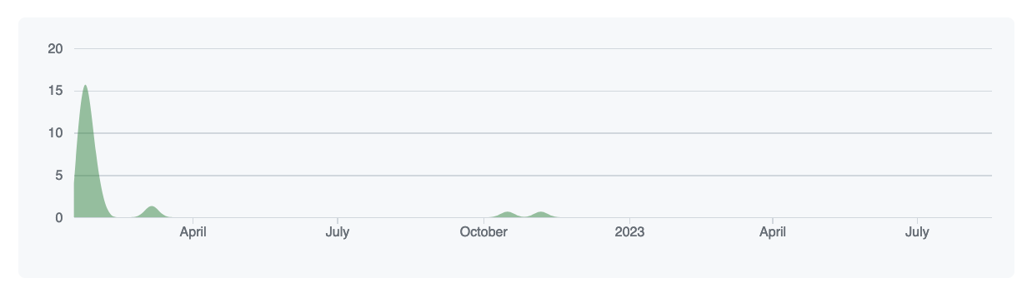
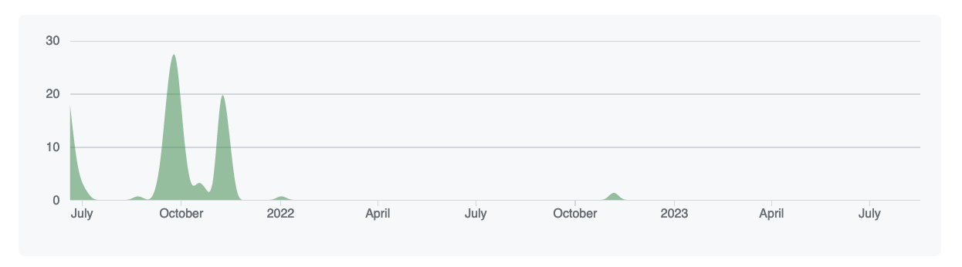
Tip: Luck is important
Some one-evening projects would get you hundreds of likes
Some months-long projects would get you totally unnoticed
1 evening
3 months

Slide 14
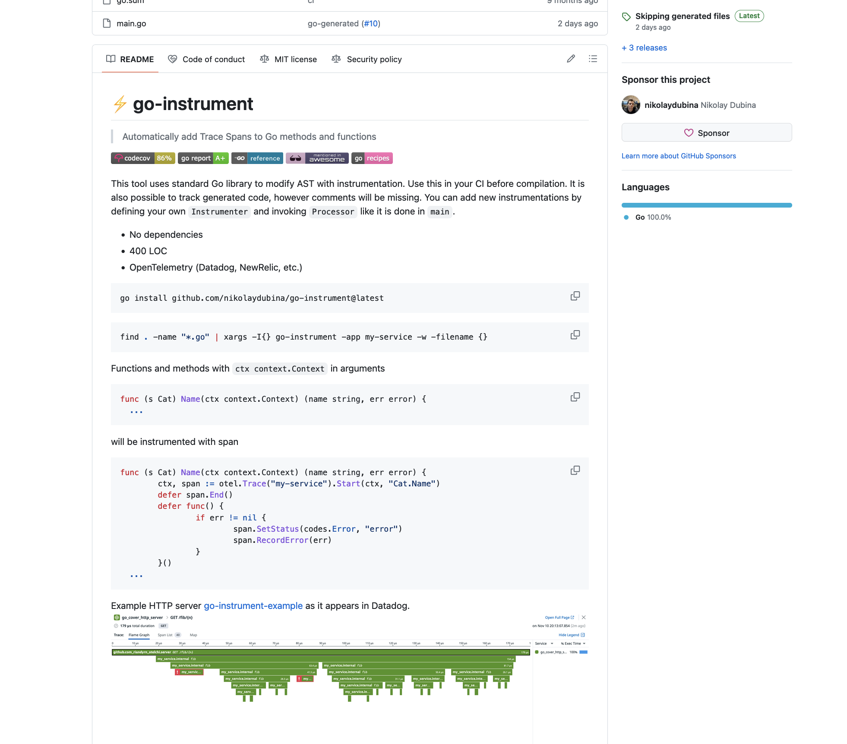
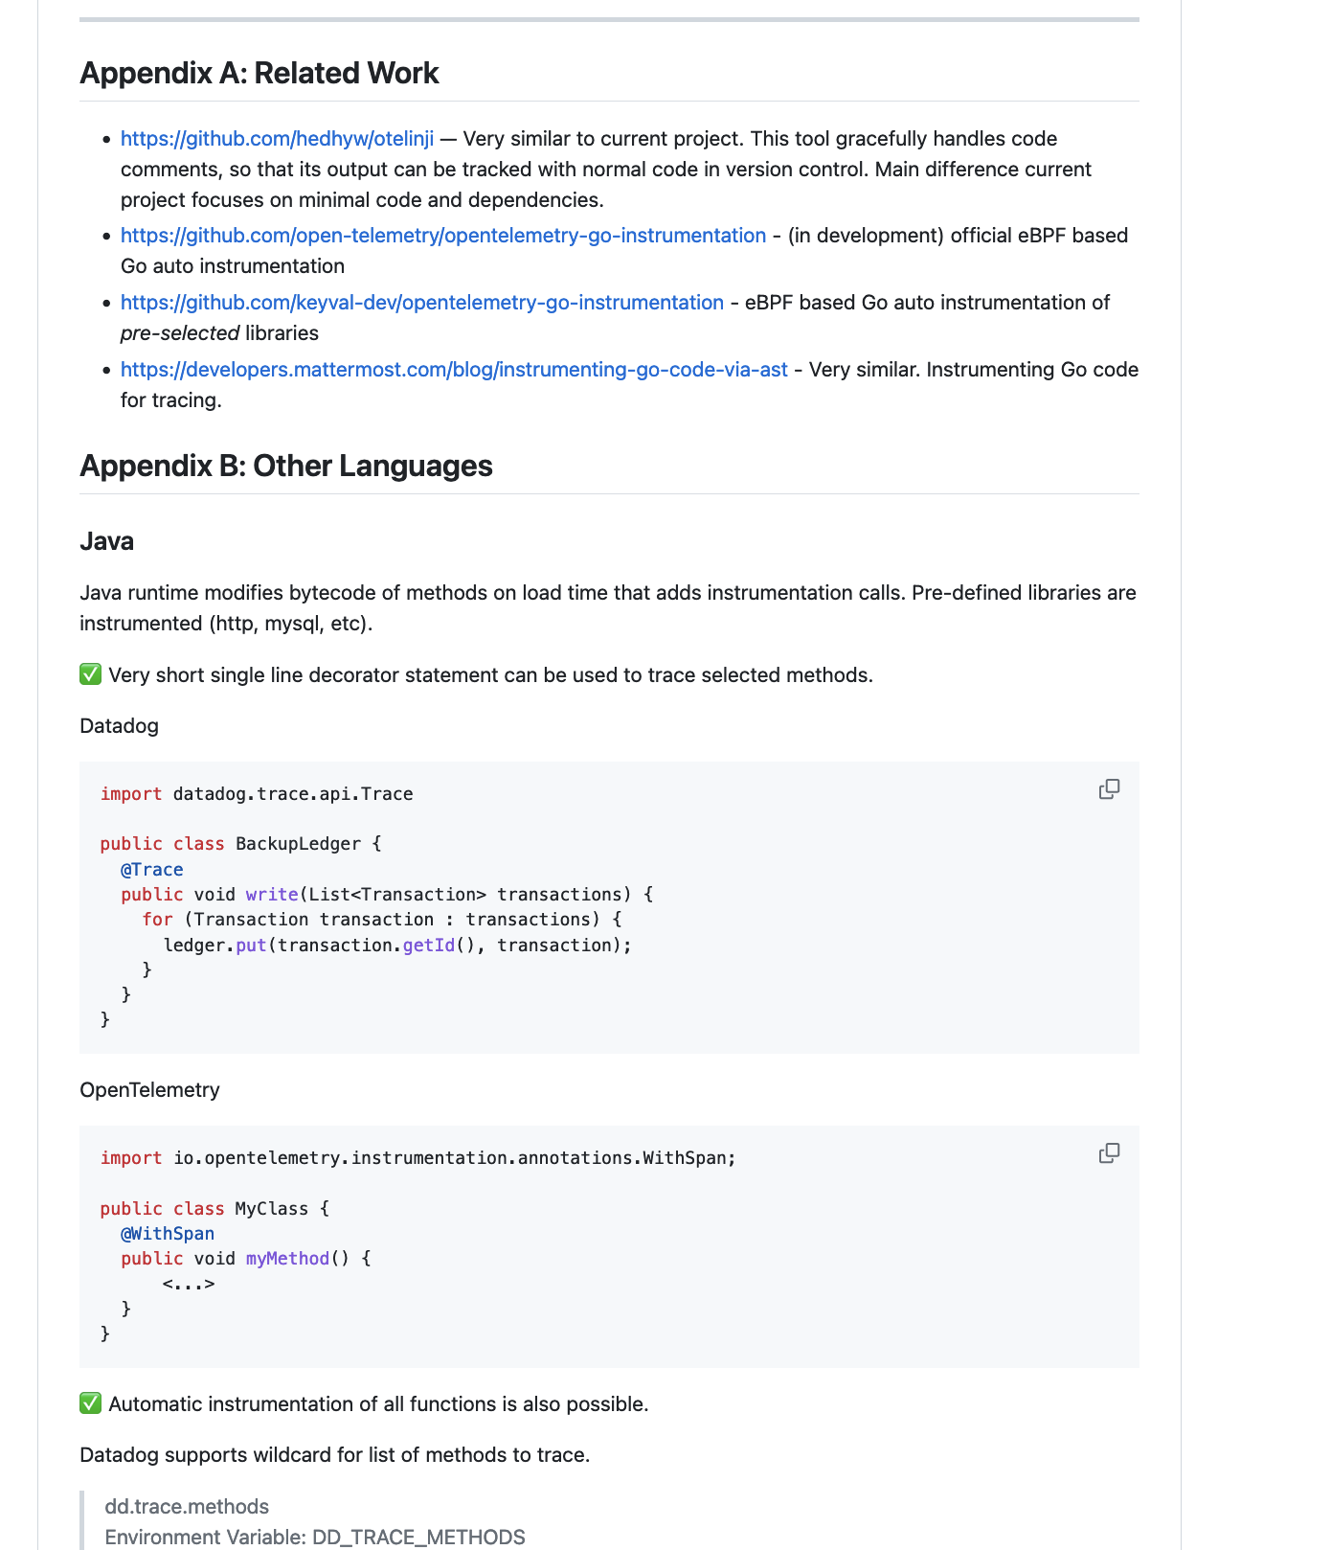
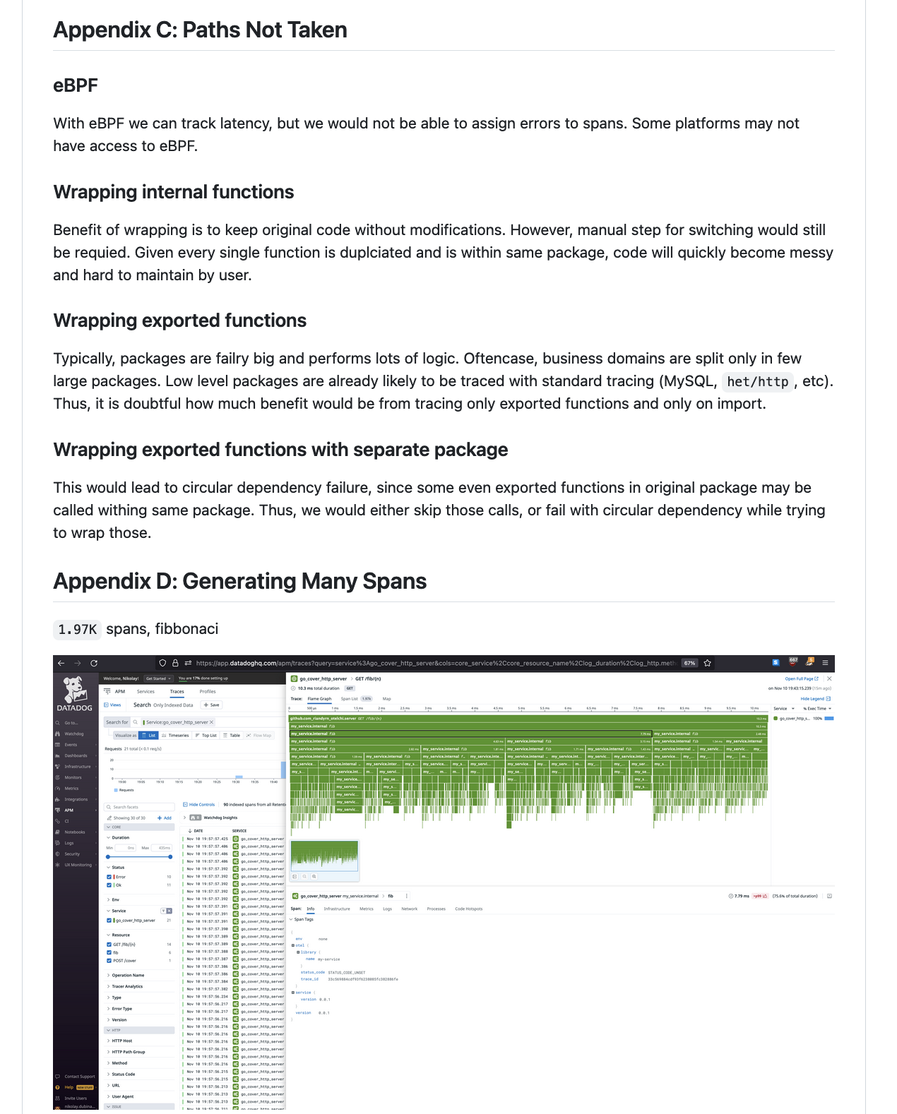
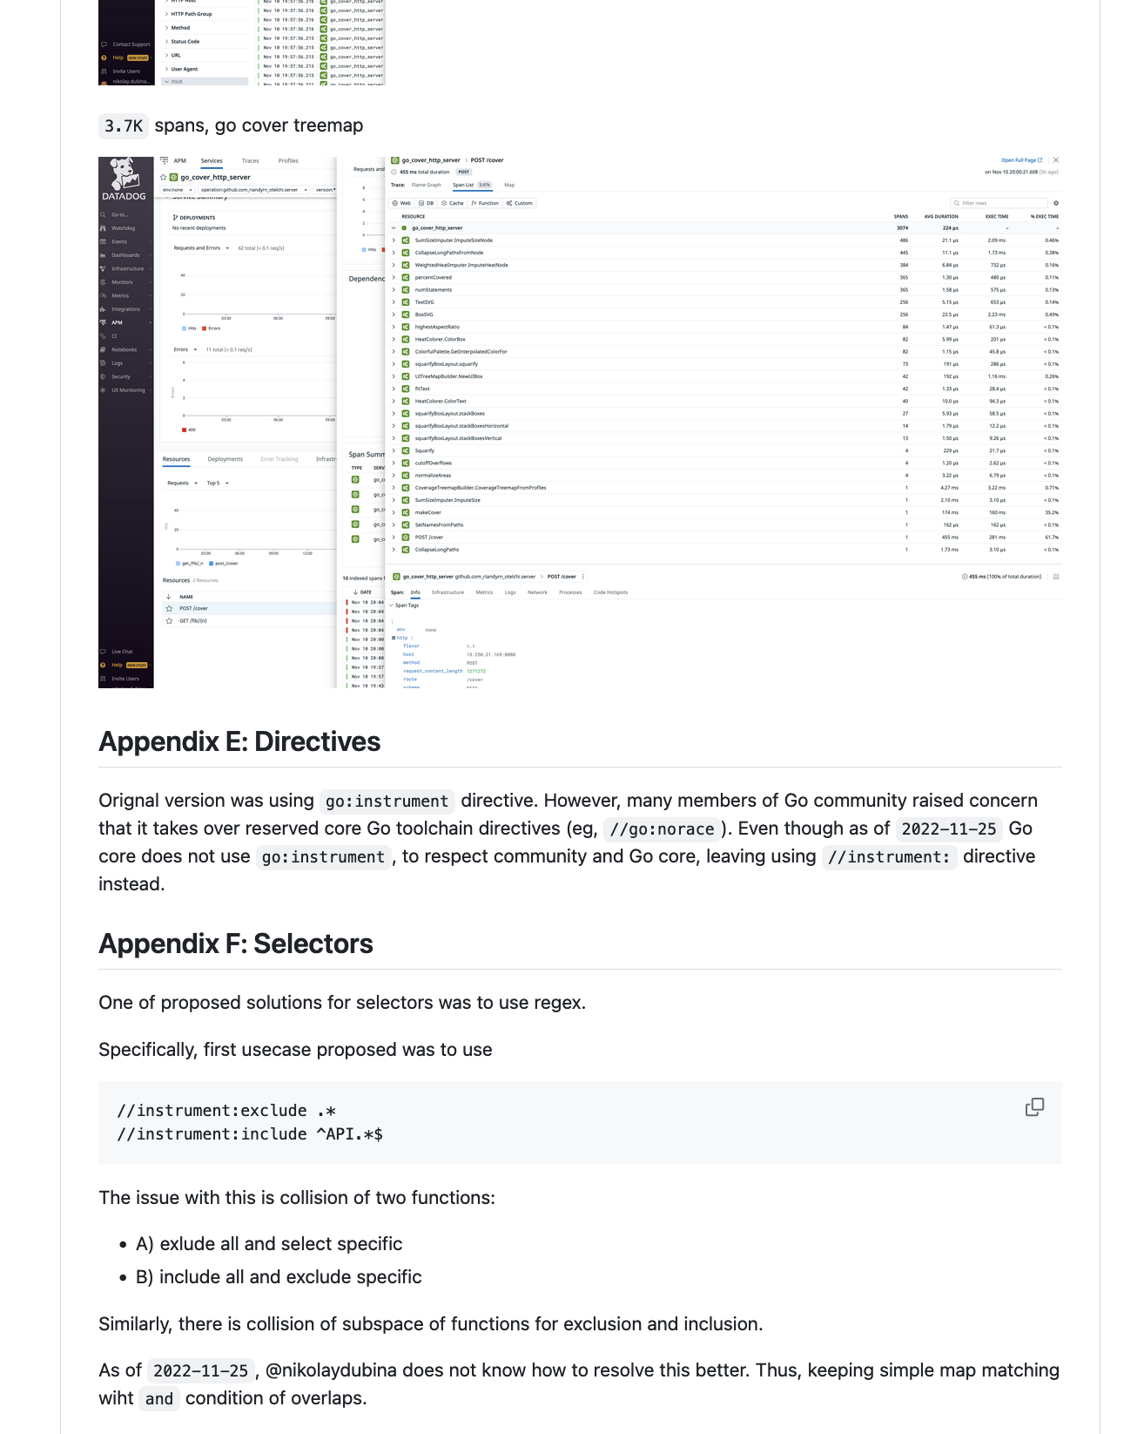
Tip: Documentation is important
Most traffic would not even scroll your Readme
forget about installing and trying it out
Show that you have tests and coverage
Show that it is actually working
Show how to get it with copy-paste command
Show how to run it with copy-paste command
Show example output
But don't be too brief

Slide 15
Tip: Make Something People Want
Don't know what people want? Build something you want, but don't have
Build something you passionate about
Build something you think you can do better
Fix bugs in major project
Accept rate is very high, but expect back-and-forth
Improve things in major projects
Accept rate is low
expect discussions before Merge or even implementation
expect strong opinions and communications
Nourish your sense what people want

Slide 16
Tip: Events
hacktoberfest.com — October
24pullrequests.com — December
why?
as a contributor, good opportunity to make PRs to other projects
I did few PRs before, but nothing major
as a host, new small traffic to your project
however, never got PRs from it

Slide 17
Tip: Don't Listen to Naysayers
Negative feedback is strong and devastating
You can criticize a project before it even started to its grave
It is on you to persevere
Without you it would not happen

Slide 18
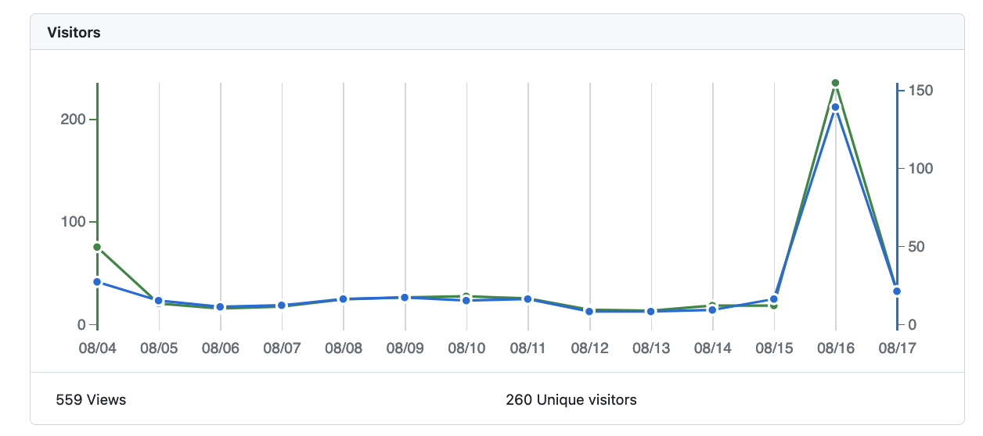
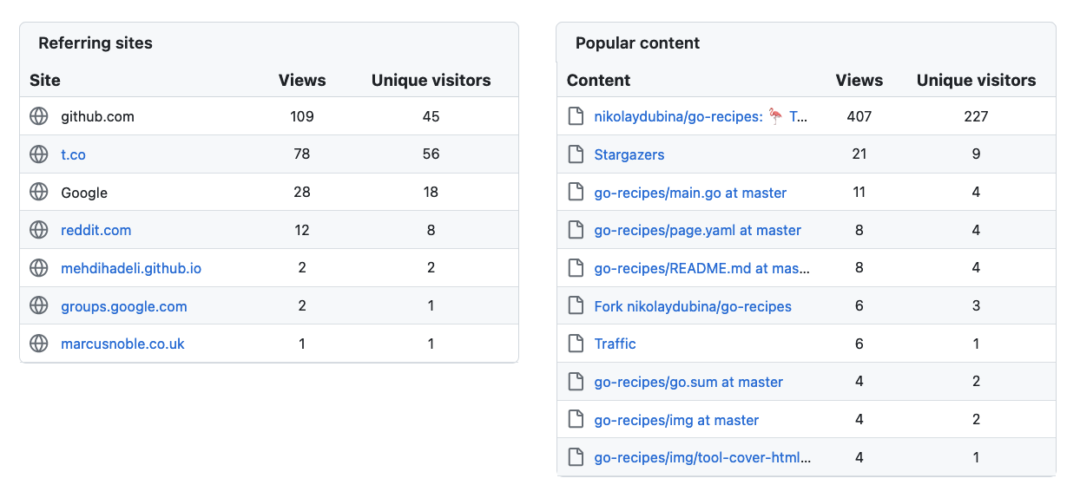
Tip: How does traffic look like?

Slide 19
Tip: Exponential Curve is Real
0 to 1
1 to 10
10 to 100
100 to 1,000
1,000 to 10,000
... all have different rules of the game

Slide 20
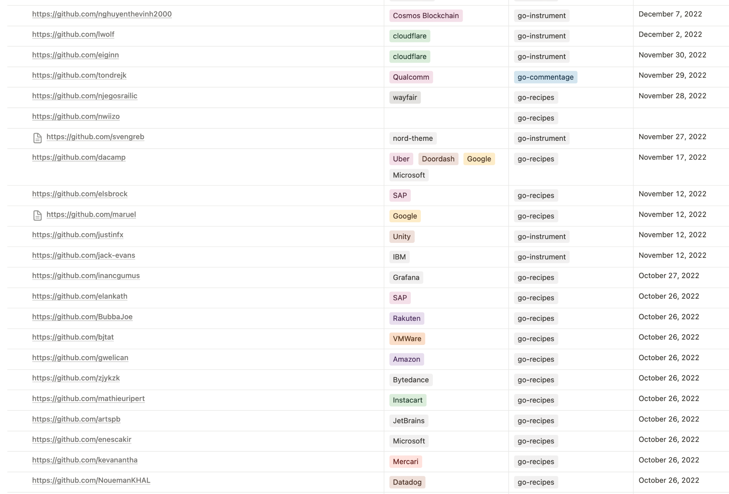
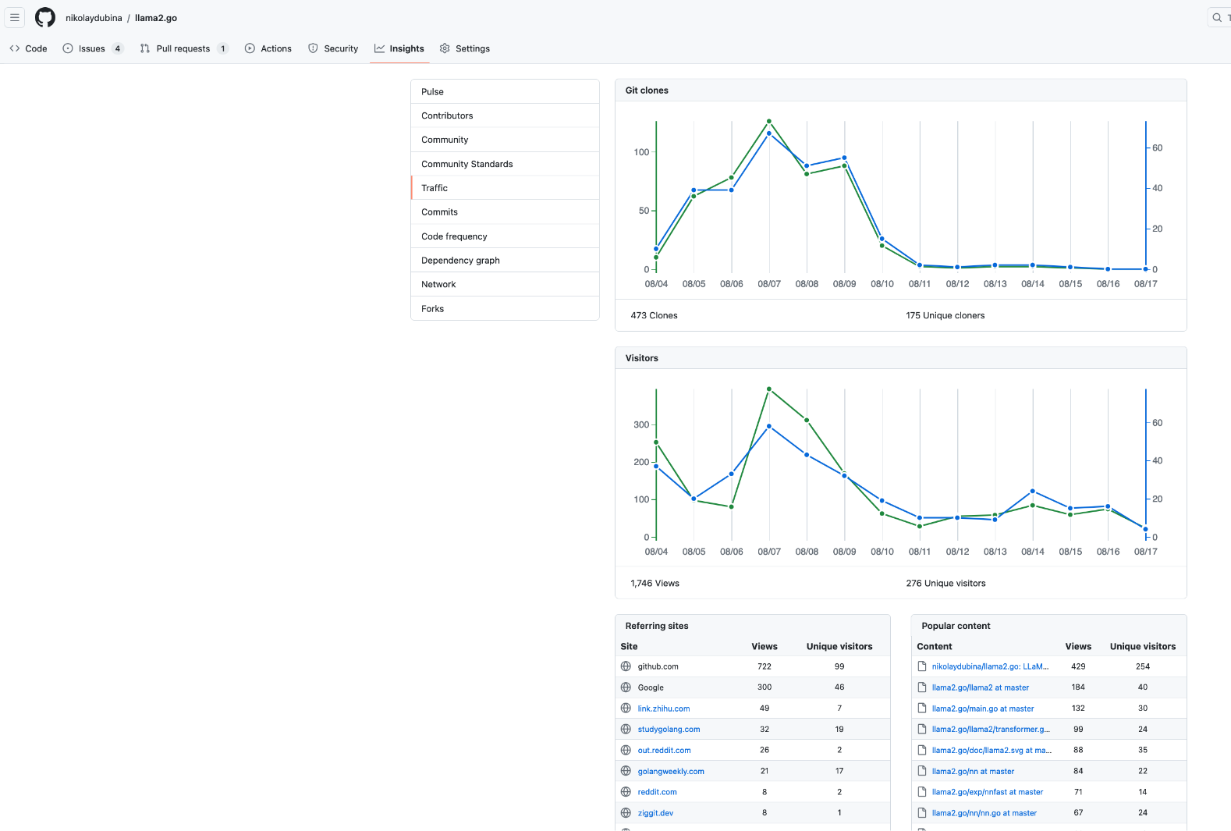
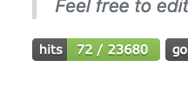
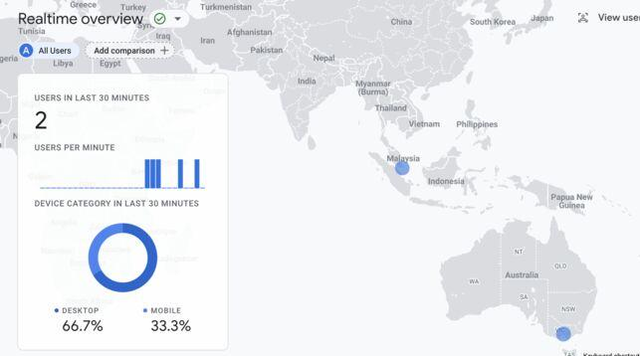
Tip: Fill your Cookie-Jar
GitHub Project Insights
Google Analytics for websites
Page Hits for Readmes
https://hits.seeyoufarm.com/
Collect who is liking your projects

Slide 21
Thank you!

